Slide 1
Chapter 2 Operating-System Structures

Slide 2
Outline
Operating System Services
System Calls
Operating-System Design and Implementation
Operating-System Structure

Slide 3
Outline
Operating System Services
System Calls
Operating-System Design and Implementation
Operating-System Structure

Slide 4
Operating System Services
OS provides services to programs
Program execution
Manage hardware
……

Slide 5
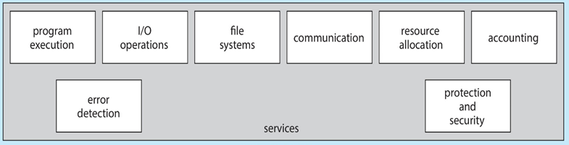
Program 1
Program 2
User Mode
Kernel Mode
OS
hardware 1
hardware 2
hardware 3

Slide 6
Outline
Operating System Services
System Calls
Operating-System Design and Implementation
Operating-System Structure

Slide 7
Q:應用程式如何存取作業系統提供的服務呢?

Slide 8
Outline
Operating System Services
System Calls
What is System Calls?
System calls versus APIs
How to Pass Parameter
Operating-System Design and Implementation
Operating-System Structure

Slide 9
Question:假設在C程式裡要存取硬碟上的某個檔案,如何做到呢?
Hint: 一定是請OS執行!

Slide 10
Question: 所以, 如何請OS執行呢?
Ans: 呼叫OS提供的functions, 例如:open(), read(), write(), close()…
參看下頁例子

Slide 11
Example
#include<stdio.h> #include<sys/types.h> #include<sys/stat.h>
#include<fcntl.h> #include<unistd.h>
#include<stdlib.h> //for exit()
#include <string.h> //for strlen()
int main(){
int fd;
fd = open("myfile.txt", O_CREAT | O_WRONLY, 0600);
if (fd < 0){
printf("Failed to open the fild.\n");exit(1); }
int size;
size = write(fd, "e", strlen("e") );
close(fd);
printf("length of write data=%d \n", strlen("e"));
printf("Number of bytes written on success=%d \n\n", size);
exit(0);
}

Slide 12
按照程式執行的規則，當呼叫open()時，程式應該會跳到對應的open() function。
問題：open() function在哪裡？

Slide 13
open()在OS內部(see the following slide) 這個例子：open()就是一個system call
所以, 何謂system call呢?

Slide 14
System Calls
System calls
Functions provided by OS to provide service to user applications
Example: open(), read(), write(), close()……
換言之, OS提供許多functions(system calls)給應用程式, 應用程式藉由呼叫system call存取OS提供的服務

Slide 15
Program 1
open()…
Program 2
read()…
User Mode
open(), read()
Kernel Mode
open()
{
….
}
read() OS
{
…
}
Storage

Slide 16
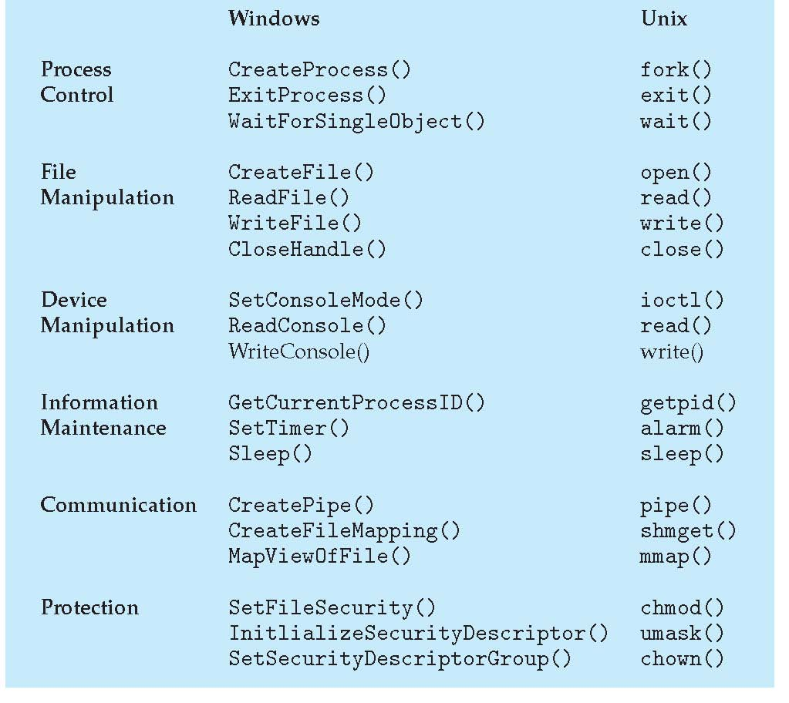
Someof Windows and Unix System Calls
問題：為什麼system call介面不一樣?

Slide 17
Question: 呼叫system call, CPU如何跳到OS內部執行呢?
Hint: C語言是假象, 我們要看CPU instructions

Slide 18
呼叫open(), compiler會轉換為int 的CPU instruction

Slide 19
System Call Compilation
…
open();
…
…
int 0x80;
…
Compile

Slide 20
System Calls (Cont.)
…
int 0x10; // read();
…
CPU
…..
mode = 0;
mode = 1;
trap
OS

Slide 21
Question: OS提供很多system calls, 當CPU執行int instruction跳到OS執行時, OS如何知道應用程式呼叫哪一個system call?

Slide 22
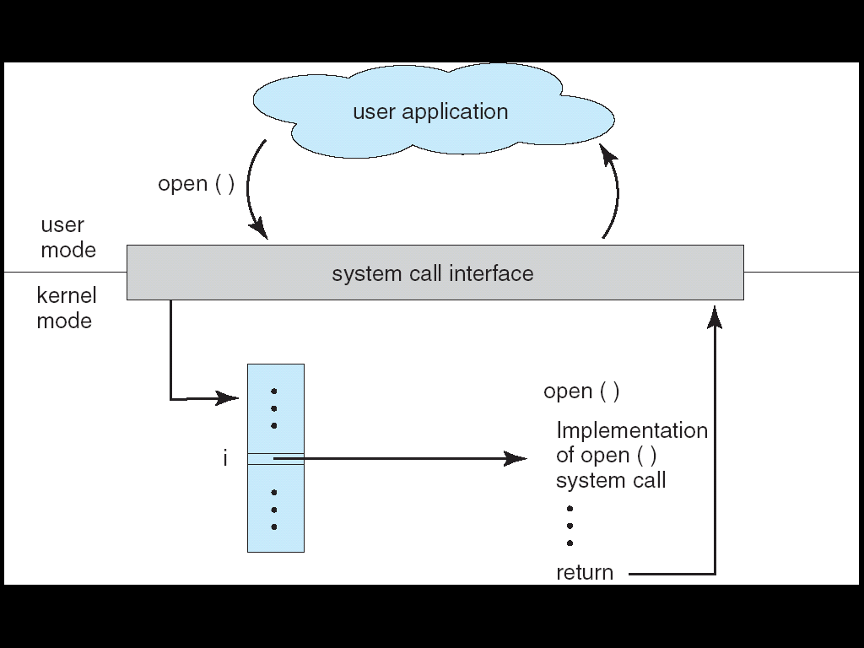
System Calls (Cont.)
A number is associated with each system call
OS maintain a table indexed according to these numbers

Slide 23
Outline
Operating System Services
System Calls
What is System Calls?
System calls versus APIs
How to Pass Parameter
Operating-System Design and Implementation
Operating-System Structure

Slide 24
APIs
However, system calls are often accessed indirectly via a Application Program Interface (API)
Rather than directly calling the system call
fopen(), fread(), fwrite(), printf()….are APIs
See the following slide

Slide 25
Q: 什麼是APIs?
Before discussing APIs, 我們先複習Library

Slide 26
Example of Programs Using Libraries in Linux
int add(int arg) {
arg++;
return arg;
}
int sub(int arg) {
arg--;
return arg;
}
int abc() {
…
}
a.c
int sum(int arg1, int arg2)
{
return (arg1+arg2);
}
int xyz()
{
……
}
b.c

Slide 27
Example of Programs Using Libraries in Linux (Cont.)
libtmp.a
a.c
Compiler
a.o
a.o
link utility
Compiler
b.o
b.c
b.o
Creating a library called libtmp.a

Slide 28
Example of Programs Using Libraries in Linux (Cont.)
Compile source programs to object programs
gcc –c main.c
gcc –c a.c
gcc –c b.c
Create/add/replace object programs into library
ar –r libtmp.a a.o
ar –r libtmp.a b.o
List contents of library
ar –t libtmp.a
Delete object programs from library
ar –d libtmp.a b.o

Slide 29
Example of Programs Using Libraries in Linux (Cont.)
#include <stdio.h>
extern int add(int);
extern int sub(int);
extern int sum(int, int);
main()
{
int ret1, ret2, ret3;
ret1 = add(5);
ret2 = sub(5);
ret3 = sum(ret1, ret2);
printf("\n ret from add()= %d", ret1);
printf("\n ret from sub()= %d", ret2);
printf("\n ret from sum()= %d", ret3);
}
int add(int arg) {
arg++;
return arg;
}
int sub(int arg) {
arg--;
return arg;
}
int abc() {
…
}
a.c
main.c
int sum(int arg1, int arg2)
{
return (arg1+arg2);
}
int xyz()
{
……
}
b.c

Slide 30
Example of Programs Using Libraries in Linux (Cont.)
Object file
executable file
Source file
main.c
Compiler
main.o
main.o
linker
libtmp.a
libtmp.a
a.o
a.o
b.o
b.o
Link with libtmp.a to create the executable file

Slide 31
複習：Linker主要的工作是resolve external references (組合語言與系統程式)

Slide 32
Example of Programs Using Libraries in Linux (Cont.)
Compile source programs to object programs
gcc –c main.c
Using library in programs
Ex. gcc main.o libtmp.a –o prog
Ex. gcc main.o –L. –ltmp –o prog
Linking editor
ld under Liunx
References
man gcc under Linux
man ar under Linux
man ld under Linux

Slide 33
在這個例子, add(), sub(), sum(), xyz()就是APIs
We also have an OS Lab discussing how to create a library.

Slide 34
複習結束

Slide 35
在目前, 我們寫程式多半都是先呼叫Library提供的APIs, 然後Library再做真正的system calls
當然也有直接呼叫system call

Slide 36
Program 1
Program 2
fopen();
fopen() {
…
open();
…
}
C library
User Mode
Kernel Mode
open()
{
….
}
read() OS
{
…
}
Storage
C program invoking fopen () library call, which in turn calls open () system call

Slide 37
Example: Standard C Library
#include <stdio.h>
int main()
{
printf(“Greeting”);
…
}
Application
printf()
{
…
int 0x80;
…
}
C Library
(libc provides a wrapper of system calls.)
write()
{
…
…
}
OS
Hardware
Hardware
C program invoking printf() library call, which in turn calls write() system call

Slide 38
在上述的例子，fopen(), fread(), printf()……都是API

Slide 39
System Call and APIs
Application Program
Library API Function
(Ex:C Library, Windows Library)
OS Function
Hardware

Slide 40
Calling System Call and APIs: Example
#include<stdio.h> #include<sys/types.h> #include<sys/stat.h>
#include<fcntl.h> #include<unistd.h>
#include<stdlib.h> //for exit()
#include <string.h> //for strlen()
int main(){
int fd;
fd = open("myfile.txt", O_CREAT | O_WRONLY, 0600);
if (fd < 0){
printf("Failed to open the fild.\n");exit(1); }
int size;
size = write(fd, "e", strlen("e") );
close(fd);
printf("length of write data=%d \n", strlen("e"));
printf("Number of bytes written on success=%d \n\n", size);
exit(0);
}

Slide 41
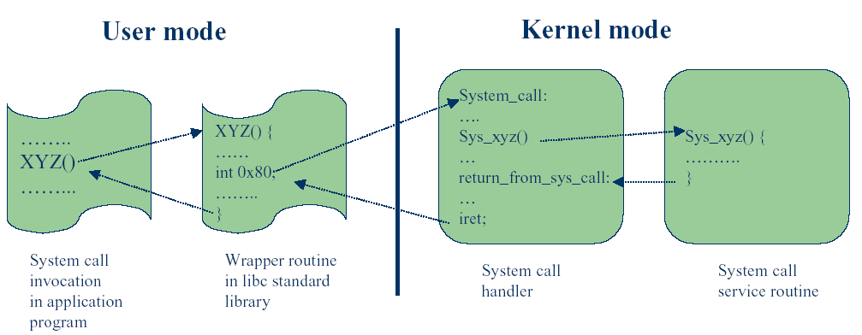
System Call and APIs

Slide 42
Q: 什麼是APIs?
API: a set of functions provided by library that can be called by the programs

Slide 43
APIs
Three most common APIs
Win32 API for Windows
POSIX API for POSIX-based systems
All versions of UNIX, Linux, and Mac OS X
Java API for the Java virtual machine (JVM)
Supported by library
Kernel32.lib is the library of Win32 API (see the following slide)

Slide 44
複習：組合語言(Linking to a Library)
The two LIB files: irvine32.lib, and kernel32.lib
The irvine32.lib is provided by book’s author
The kernel32.lib is part of the Microsoft Win32 Software Development Kit (SDK)

Slide 45
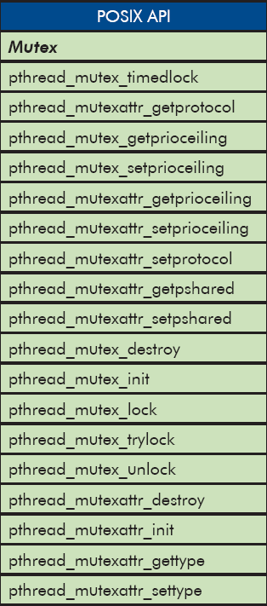
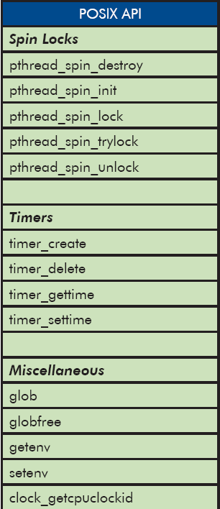
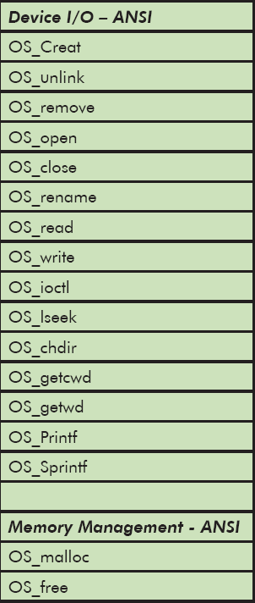
Some of POSIX APIs

Slide 46
Question: 為什麼要先呼叫APIs,再由APIs做真正的system call?

Slide 47
APIs (Cont.)
Why use APIs rather than system calls?
Portability
Application using APIs can be compiled and run on another platform without modification (see the following slides)
Easier to use
System calls often be more detailed and difficult to use than APIs

Slide 48
APIs (Cont.)
Why use APIs rather than system calls?
Portability
Application using APIs can be compiled and run on another platform without modification (see the following slides)
Easier to use
System calls often be more detailed and difficult to use than APIs

Slide 49
Some of Windows and Unix System Calls

Slide 50
Portability (Cont.)
…
CreateProcess()
…
…
fork()
…
Change to Linux
Need to modify
the source code
Windows
Linux
CreateProcess()
fork()
since system call interface
is different

Slide 51
Portability
…
pthread_create()
…
…
pthread_create()
…
Change to VxWorks
Don’t need to modify
the source code
POSIX Library
POSIX Library
Linux
VxWorks
fork()
new_thread()
even system call interface
is different

Slide 52
APIs (Cont.)
Why use APIs rather than system calls?
Portability
Application using APIs can be compiled and run on another platform without modification (see the following slides)
Easier to use
System calls often be more detailed and difficult to use than APIs
Example: printf() provides output formatting, whereas write() system call just outputs a block of bytes

Slide 53
例子: 假設你要在銀幕上印出 “You are 20 years old.”
分別使用printf() C library function和write() system call

Slide 54
Calling printf() C Library Function
int main()
{
unsigned int age = 20;
printf("You are %d years old.\n", age);
}

Slide 55
Calling write() System Call
int main() { int num = 20; char digits[10]; // 暫存每一位數字（反向存） int len = 0; // 將整數轉換為字元（反向存入 digits[]） while (num > 0) { int digit = num % 10; digits[len++] = '0' + digit; num = num / 10; } // 先寫固定文字 write(1, "You are ", 8); // 反向寫出數字（從最高位開始） for (int i = len - 1; i >= 0; i--) { write(1, &digits[i], 1); } // 再寫剩下的句子 write(1, " years old.\n", 13); return 0; }

Slide 56
心得: 呼叫printf()比呼叫write() system call方便許多!
我們會有一個作業系統實驗比較兩者的差異

Slide 57
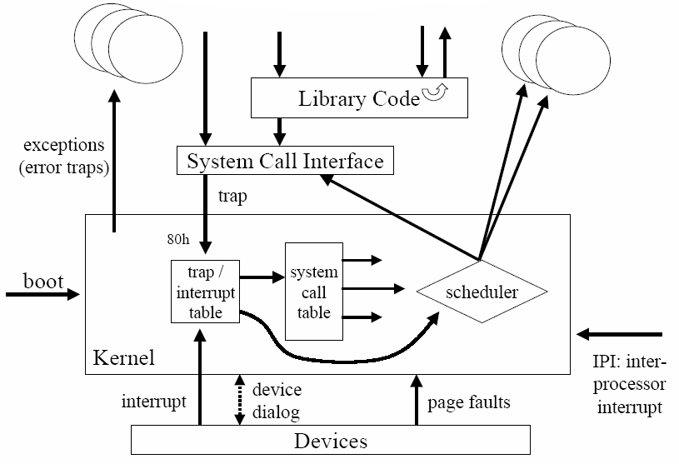
Summary

Slide 58
Outline
Operating System Services
System Calls
What is System Calls?
System calls versus APIs
How to Pass Parameter
Operating-System Design and Implementation
Operating-System Structure

Slide 59
問題：當呼叫system call時，如何傳遞參數給作業系統？
如下圖：應用程式如何傳遞參數給作業系統?

Slide 60
…
SYS_XYZ(…);
…
CPU
…..
OS
SYS_XYZ()
{
…
}

Slide 61
Hint: 你要拿東西給同學, 可是你們不會碰面!怎麼辦呢?
你=應用程式, 東西=參數, 同學=作業系統, 你們不會碰面=在記憶體的不同位置
Sol: 放在一個你們彼此都會存取的地方(例如:338教室)

Slide 62
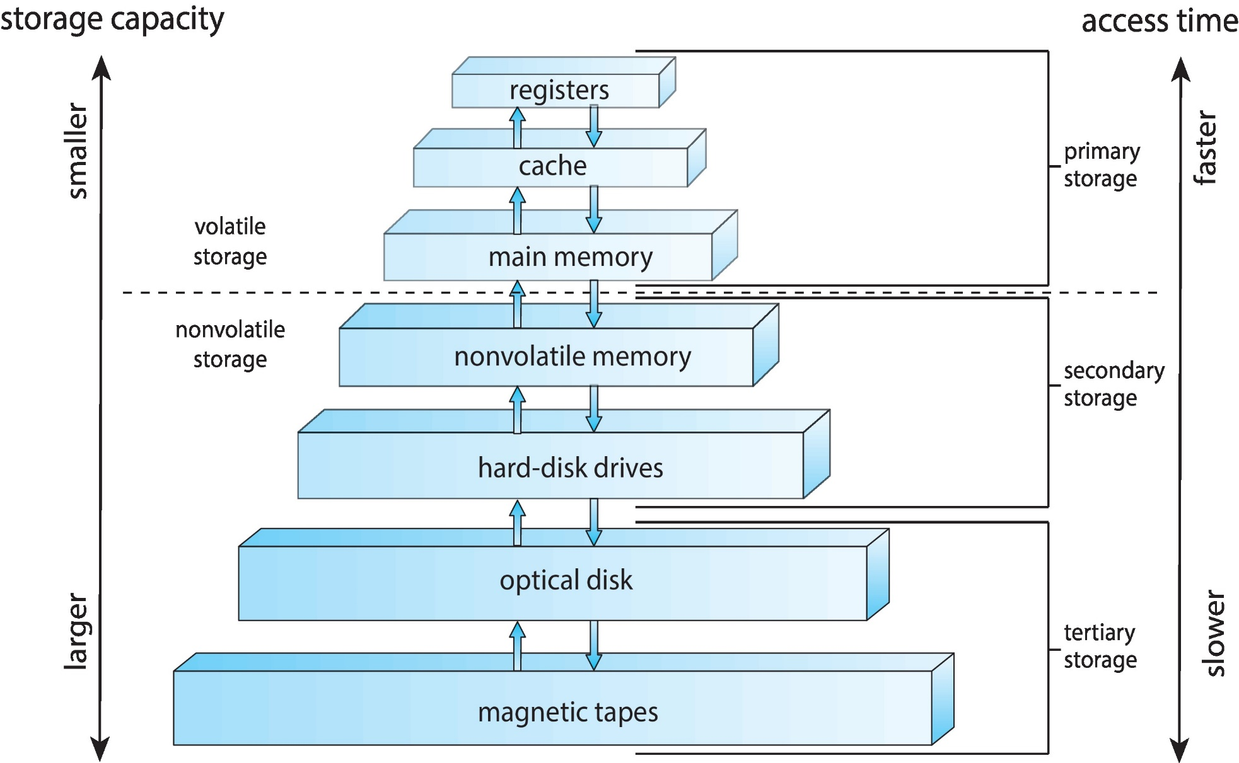
Idea: Storage Hierarchy

Slide 63
System Call Parameter Passing
Three methods used to pass parameters to the OS
In registers
In some cases, may be more parameters than registers
In a block in memory, and the starting address of block passed in a register
Taken by Linux and Solaris
In stack
Programs pushed onto the stack and popped off the stack by the OS

Slide 64
System Call Parameter Passing
Three methods used to pass parameters to the OS
In registers
In some cases, may be more parameters than registers
In a block in memory, and the starting address of block passed in a register
Taken by Linux and Solaris
In stack
Programs pushed onto the stack and popped off the stack by the OS

Slide 65
Passing Parameters to System Calls: CPU Registers
mov eax, 10
mov ebx, 20
int SYS_XYZ;
……
User Mode
system_call
Kernel Mode
SYS_XYZ :
mov a, eax; a = 10;
mov b, ebx; b = 20;
……

Slide 66
Passing Parameters to System Calls: CPU Registers
…
mov eax, 10
mov ebx, 20
int 0x10; //SYS_XYZ;
…
CPU
eax | 10
ebx | 20
…..
OS
SYS_XYZ()
{
…
}

Slide 67
System Call Parameter Passing
Three methods used to pass parameters to the OS
In registers
In some cases, may be more parameters than registers
In a block in memory, and the starting address of block passed in a register
Taken by Linux and Solaris
In stack
Programs pushed onto the stack and popped off the stack by the OS

Slide 68
Passing Parameters to System Calls: Memory Block
mov eax, 0x1000
int SYS_XYZ;
……
User Mode
Kernel Mode
system_call
SYS_XYZ :
user parameters pointed by eax
……

Slide 69
Passing Parameters to System Calls: Memory Block
…
move eax, 0x1000
int 0x10; //SYS_XYZ;
…
…
…
CPU
 | 0x1000
greetings
…..
eax | 0x1000
OS
SYS_XYZ()
{
read parameter
from [eax]
}

Slide 70
System Call Parameter Passing
Three methods used to pass parameters to the OS
In registers
In some cases, may be more parameters than registers
In a block in memory, and the starting address of block passed in a register
Taken by Linux and Solaris
In stack
Programs pushed onto the stack and popped off the stack by the OS

Slide 71
Passing Parameters to System Calls: Stack
push 10
push 20
int SYS_XYZ;
……
User Mode
system_call
Kernel Mode
SYS_XYZ:
pop a; // a = 20;
pop b; // b = 10;
……

Slide 72
Passing Parameters to System Calls: Stack
…
push 10
push 20
int 0x10; //SYS_XYZ;
CPU
10
20
OS
SYS_XYZ()
{
…
}

Slide 73
事實上, 你已經學過如何傳遞參數了!
複習:組合語言第八章 (Advanced Procedures)

Slide 74
Procedure Parameters
Two types of procedure parameters
Register parameters
Stack parameters
Register parameters
Intended to optimize for program execution speed
But not always true! (see the page. 10)
Stack parameters
Nearly all high-level language uses them

Slide 75
Register Parameter v.s. Stack Parameters
Imagine two possible ways of calling the DumpMem procedure.
mov esi,OFFSET array
mov ecx,LENGTHOF array
mov ebx,TYPE array
call DumpMem
push OFFSET array
push LENGTHOF array
push TYPE array
call DumpMem

Slide 76
Register Parameter
…
mov eax, 10
mov ebx, 20
call runner;
…
CPU
eax | 10
ebx | 20
…..
runner:
{
mov a, eax
mov b, ebx
…
}

Slide 77
Stack Parameter
push 10
push 20
call runner;
…
CPU
…..
10
20
stack
runner:
{
access 10;
access 20;
……
}

Slide 78
複習結束

Slide 79
Outline
Operating System Services
System Calls
Operating-System Design and Implementation
Operating-System Structure

Slide 80
Outline
Operating System Services
System Calls
Operating-System Design and Implementation
Mechanism and policies
Operating-System Structure

Slide 81
Mechanisms and Policies
Example:
Mechanism: priority-based systems
Policy: A program have priority over B program or vice versa.
Important principle to separate mechanism and policies
Mechanism
How to do it?
Should be insensitive to changes in policy
Policy
What will be done?
Likely to change across places or over time
Separation of policy from mechanism for flexibility

Slide 82
Outline
Operating System Services
System Calls
Operating-System Design and Implementation
Operating-System Structure
Monolithic structure
Layered approach
Microkernels
Modules
Hybrid systems

Slide 83
Outline
Operating System Services
System Calls
Operating-System Design and Implementation
Operating-System Structure
Monolithic (龐大的) structure
Layered approach
Microkernels
Modules
Hybrid systems

Slide 84
Monolithic Structure
Do not have well-defined structures
Examples
MS-DOS:
Original UNIX -
Everything between the system call interface and physical hardware is the kernel.
An enormous amount of functions in one level=> monolithic (龐大的) kernel

Slide 85
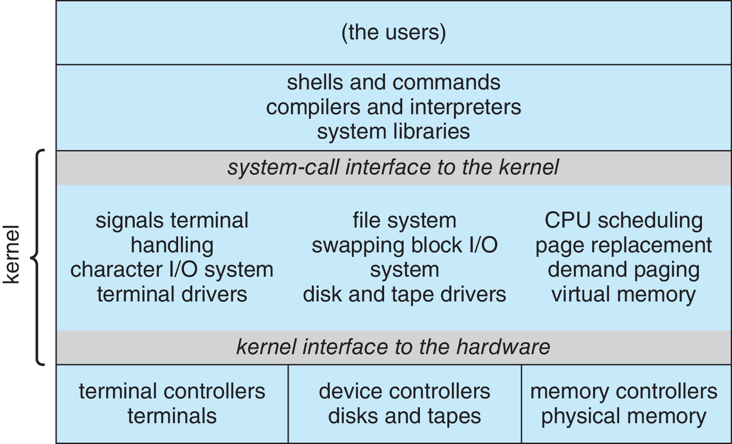
Original UNIX Architecture

Slide 86
Monolithic Structure
Monolithic Structure
Bad: Difficult to implement and extend
Good: Have a distinct performance advantage
Very little overhead in the system-call interface and communication within the kernel is fast
Discussed later
Thus, UNIX, Linux and Windows are monolithic kernels

Slide 87
Outline
Operating System Services
System Calls
Operating-System Design and Implementation
Operating-System Structure
Monolithic structure
Layered approach
Microkernels
Modules
Hybrid systems

Slide 88
Layered Approach
OS is divided into a number of layers
Layer approach: each layer uses functions and services of only lower-level layers
Advantages:
Simplicity of construction and debugging
Starts from the lowest layer
Information hiding
Do not have to know the details of the other layers

Slide 89
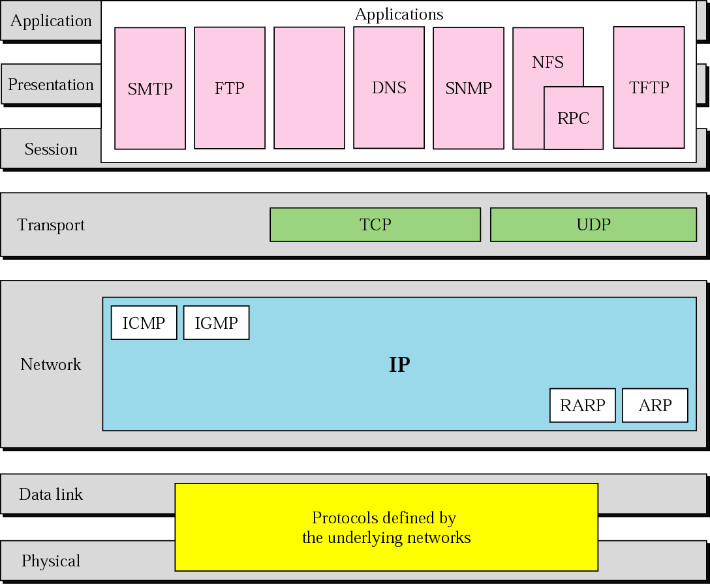
TCP/IP and OSI Model

Slide 90
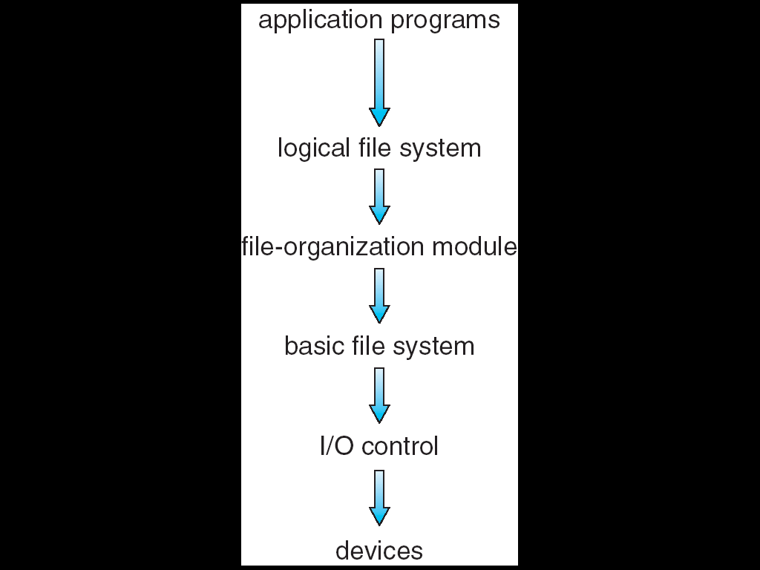
File System Organized into Layers

Slide 91
Layered Approach (Cont.)
Difficulties
Hard to determine the number of layers
Hard to define functionality of each layer
Less efficient
A service may involve multiple layers
But each layer adds overhead
Trend: fewer layers with more functionality

Slide 92
Outline
Operating System Services
System Calls
Operating-System Design and Implementation
Operating-System Structure
Monolithic structure
Layered approach
Microkernels
Modules
Hybrid systems

Slide 93
Question: UNIX became large and difficult to manage (OS太龐大了). 怎麼辦呢?
Hint: 縮小! 但如何縮小OS呢?

Slide 94
Microkernel
Idea: moves as much from the kernel into user space
A smaller kernel
移到user space的稱為services (or servers)
Mach: the first microkernel by CMU

Slide 95
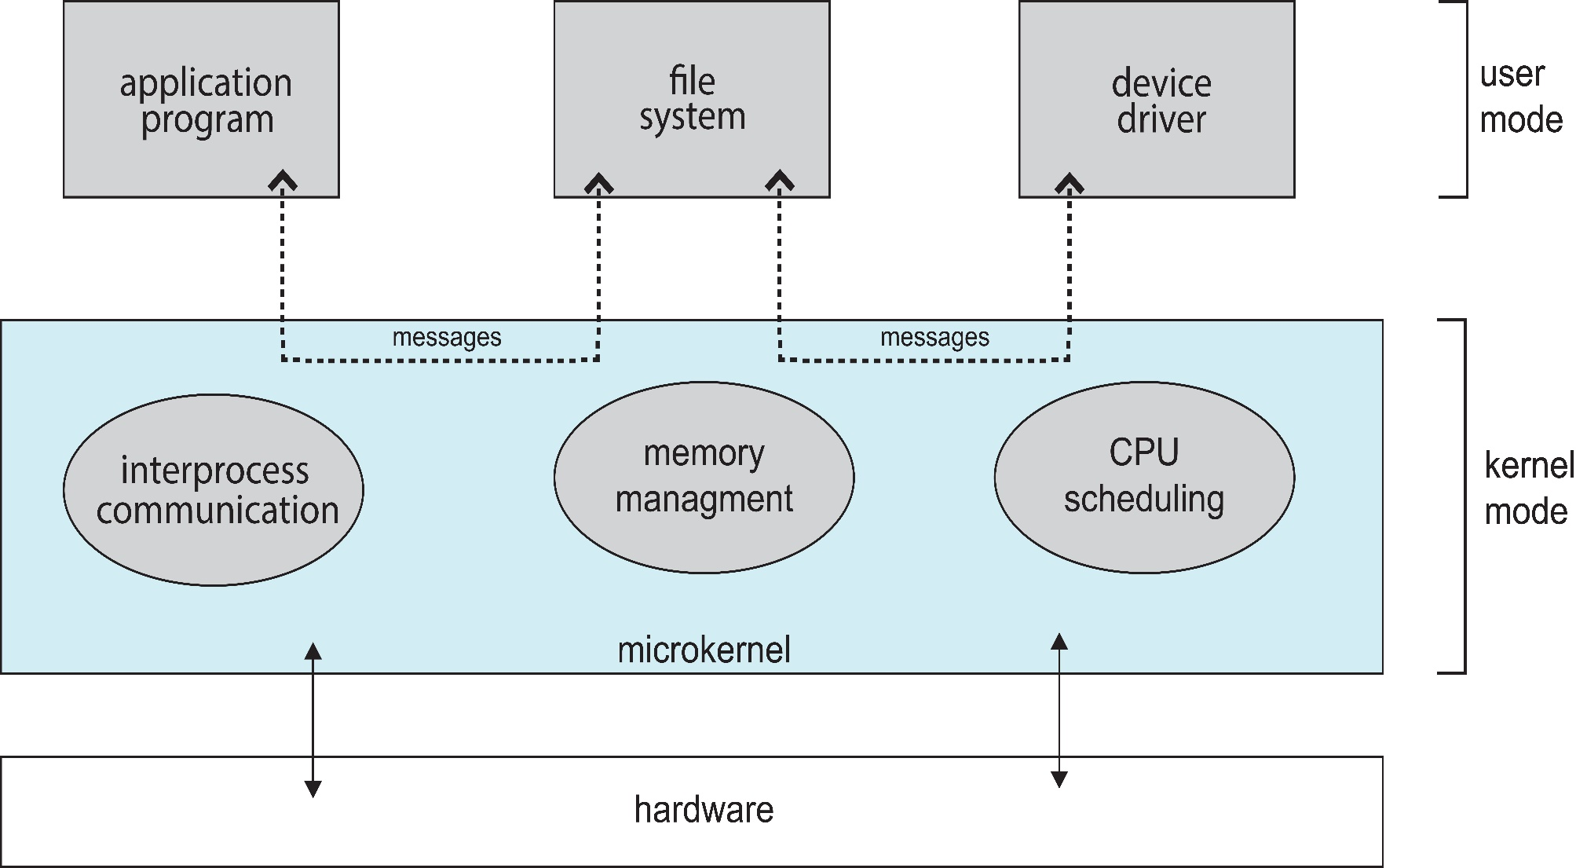
Microkernel System Structure (Introduced Later)
service
service

Slide 96
Q1: What a microkernel should provide ?
Ans: minimal process management and memory management, and a communication facility (introduced later)

Slide 97
Q2:如果應用程式要存取檔案系統, 但是檔案系統現在也是一個應用程式(services), 怎麼辦呢?
By message passing communication facility
Provide communication between client programs and the various services (introduced later)

Slide 98
Microkernel (Cont.)
Advantages:
Easier to extend the OS
By adding new services and do not require kernel modification
Easier to port the OS to new architectures
The kernel is small and the changes tend to be fewer
More reliable and more secure
Most services are running as user processes
If a service failed, the rest of the OS remains untouched
Disadvantages:
Performance overhead by message passing between services
Window NT: microkernel, Windows XP: a monolithic kernel

Slide 99
為什麼Message Passing會造成很大的overhead呢？
第三章我們會介紹

Slide 100
Outline
Operating System Services
System Calls
Operating-System Design and Implementation
Operating-System Structure
Monolithic structure
Layered approach
Microkernels
Modules
Hybrid systems

Slide 101
Modules
Best current methodology in OS design
An OS consists of
A core kernel
A set of loadable kernel modules (LKMs) that can dynamically loadable at run time

Slide 102
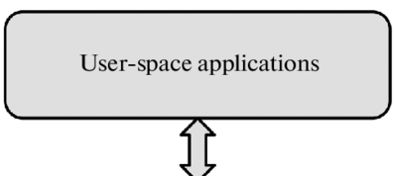
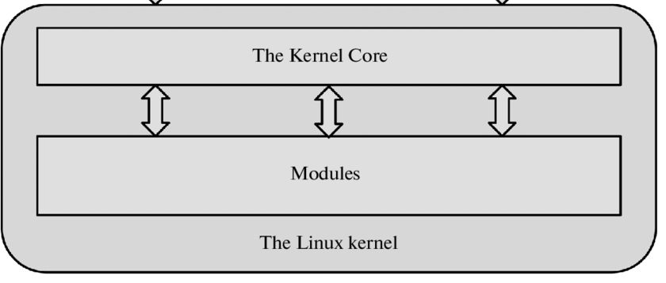
Modules
…..
module
module
module
module
Linux kernel consists of a core kernel and a set of kernel modules
https://www.researchgate.net/figure/Interaction-of-Linux-kernel-modules-with-their-environment_fig1_299373758

Slide 103
Outline
Operating System Services
System Calls
Operating-System Design and Implementation
Operating-System Structure
Monolithic structure
Layered approach
Microkernels
Modules
Hybrid systems

Slide 104
Hybrid Systems
Modern operating systems do not adopt a single structure
Hybrid systems combine multiple structures
Linux is monolithic,
+ modules for dynamic loading of functionality
Windows is mostly monolithic
+ personalities (user-level services) (microkernel)
+ modular for dynamic loading of functionality

